Slide 1
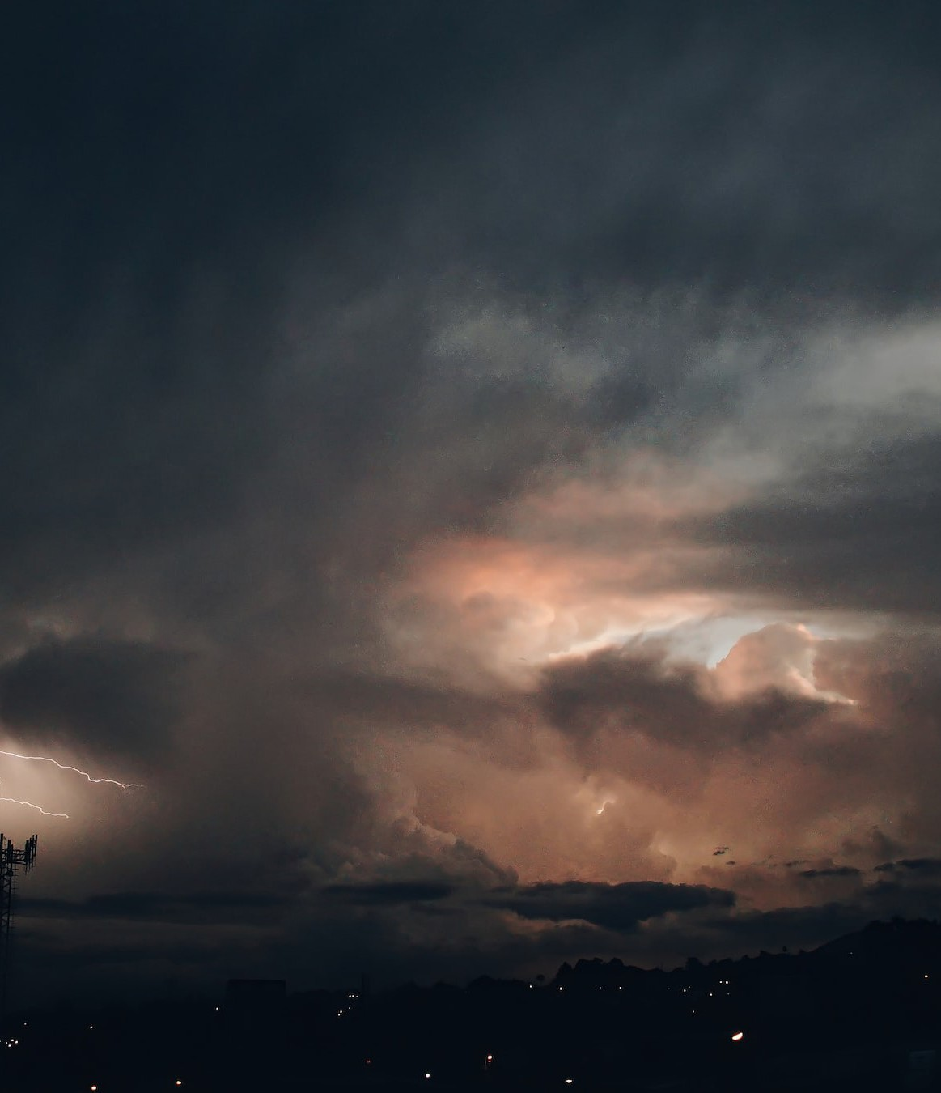
TEMA: project
presentation
April 15, 2024
This project has received funding from the European Union’s HE research and innovation programme under the grant agreement No. 101093003

Slide 2
The Project at a Glance
PROJECT NAME:
TEMA
Trusted Extremely Precise Mapping and Prediction for Emergency Management
CALL:
HORIZON-CL4-2022-DATA-01-01
Methods for exploiting data and knowledge for extremely precise outcomes (analysis, prediction, decision support), reducing complexity and presenting insights in understandable way (RIA)
Project Consortium:
19 partners
from 8 European countries,
key players in the fields of data analysis, AI, modelling, drone technologies, simulation and visualization, analytics and cloud computing, as well as policy counselling
and emergency response authorities/public bodies.
Project Duration:
48 months.
Starting date: 1 December 2022
Budget:
€ 11.340.223,50

Slide 3
Motivation

Slide 4
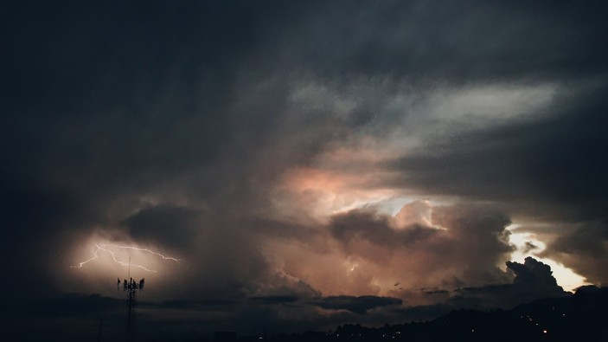
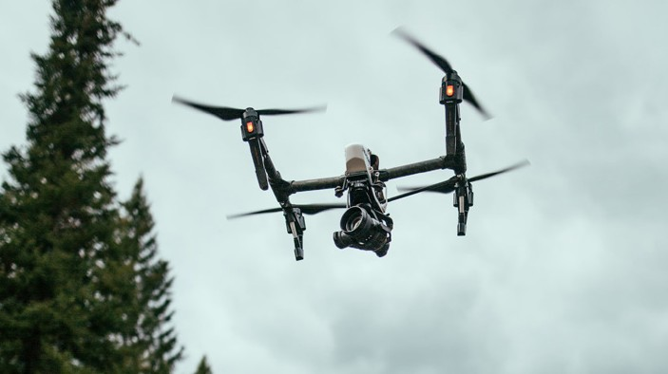
Project’s Motivation
Climate change is leading EU countries to experience increasingly frequent and damaging adverse climatic events, such as large fires and flooding. The impact of these events is expected to make EU increasingly vulnerable due to the magnitude and frequency with which they will occur in the coming years.
According to the Emergency Events Database (EM-DAT), natural hazards have cost about 3 trillion dollars of economic destruction and 1.3 million casualties, with more than 4.4 billion people injured between 1998 and 2017.
In Europe, between 1980 and 2020, disasters affected nearly 50 million people and caused economic losses of roughly €12 billion per year.
Technologies related AI, XAI and XR, which are useful for solving NDM (Natural Disaster Management) problems, have reached a very high degree
of maturity compared to just a few years ago.

Slide 5
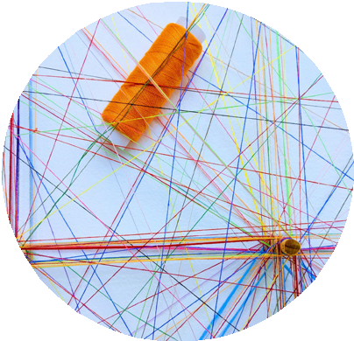
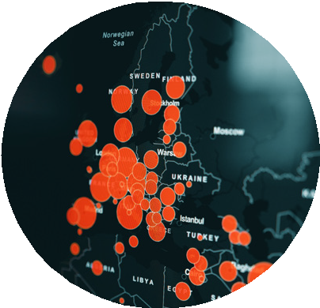
Needs / What brought us here
1 Trustworthy information:
access to heterogeneous, accurate, and reliable data is crucial to providing useful information to first responders and public protection and disaster relief
2 Transferability:
a solution provided with cloud and edge computing infrastructure can offer scalability, performance, storage, ubiquitous access and security enabling global transferability of services and products to other geographic regions and disaster types
3 Scenario prevision:
the use of cutting-edge technologies and data analysis can increase the quality, precision, and completeness of the situational picture, particularly in sub-urban and more densely populated areas, and elaborate response strategies

Slide 6
The Project
Vision

Slide 7
The Vision
TEMA aims to develop beyond-state-of-the-art technologies for facilitating
Natural Disaster Management, by dynamically exploiting data sources and Artificial Intelligence technologies in order to provide an accurate assessment
of an evolving crisis situation.
The goal is to deliver a technical solution that is supportive in disaster response and management by bringing situational data to relevant end-users, enabling transferability to tackle different disaster types in various geographic regions, thus providing the relevant information that can help make the best possible operative decisions.

Slide 8
Objectives

Slide 9
Main Objective
TEMA will be an AI-enabled NDM platform which will be validated and demonstrated
in two socially important cases: forest fires and floods.
Due to the scale and diversity of the employed extreme data and their powerful analysis, TEMA will offer precise semantic 3D area mapping and NDM event prediction over a longer time period, by taking into account all related uncertainty factors.
TEMA tools will allow precise replication and modeling of real NDM events,
while considering quality standards and assessment criteria for simulated NDM data. Advanced AR-enabled TEMA visualization will be interactive, intuitive and accessible. It will allow human operators to understand complex NDM phenomena and easily evaluate alternative response strategies, by smart selection of platform parameters and by novel ways of combining heterogeneous (visual and non-visual) data and/or AR.
Moreover, TEMA will provide a scalable and efficient NDM-Analytics-as-a-Service
(NDM-AaaS) for making the developed advanced analytics tools available over the cloud.

Slide 10
Specific Objectives
Improve and accelerate
extreme data analytics,
by increasing trustworthiness, accuracy and responsiveness of extreme data analysis algorithms;
Improve Natural Disaster Management
using new digital technologies and extreme data analytics;
Improve and accelerate
emergency phenomenon modeling, evolution predictions, simulation and interactive visualization.

Slide 11
Approach

Slide 12
Concept
TEMA Concept
Data Sources
Rapid, more qualitative response in densely populated regions
Modeling/Predictions
XR-based Interactive Visualization
Response Planning & Recommendations
Mission/path planning recommendations for optimal sensor placement
Sentinel Missions
Earlier acquisition
Early warning/ forecasting
Phenomenon Modeling
DLR ground stations (DNL-NBS)
Commercial high-res satellite missions
High resolution
UAVs/Drones
High resolution in smaller area
Rapid modeling
Case studies
Pilot Trials
Input: AOIs of simulated ﬂooded areas for targeted pre-tasking of satellites
Floods, ﬂash foods, ﬁres
Smart Sensors
Software in a cloud
Ethics, Human factors, Regulations, etc.
Global transferability to other geographic regions and disaster types
Social Media
Web-based forecasts/ warnings
Analytics
Integration with other initiatives
Earlier EO data retrieval
Web-data-based satellite data acquisition and processing
Faster more precise semantic segmentation
EO/AI-based ﬂood/ﬁre detection, monitoring and assessment
Open Web Data and Geo-Social Media Analytics
Information Fusion
More automation
More complete situational picture

Slide 13
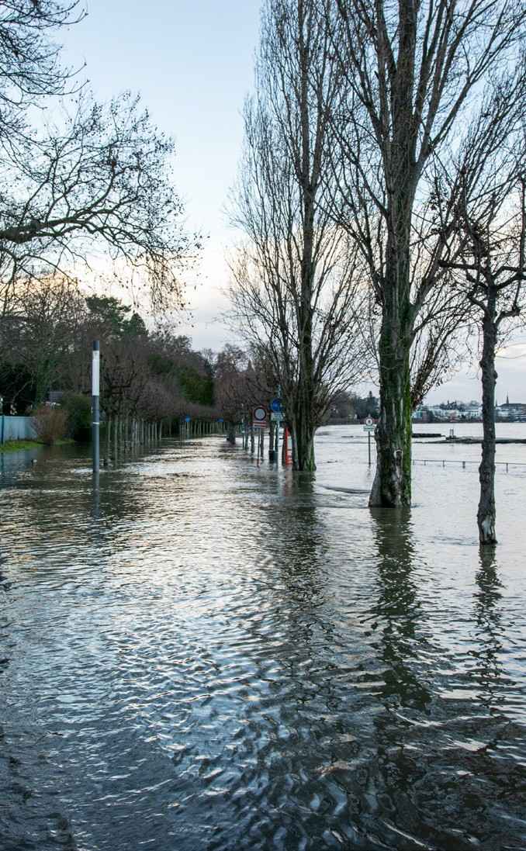
Pilots
Germany
1. Central-European Regional Floods Pilot site: Bavaria
Central Europe, due to presence of big rivers, can experience heavy persistent rains that cause regional floods, as happened during July 2021 in the German region of Ahrtal.
In this pilot, a flood model will be set-up for the area and calibrated based on information retrieved from historic flood events, including the Ahrtal flood. The objective of TEMA is to provide information to be used to warn the responsible authorities, population and public protection, and provide information about the accessibility of the affected region leading to improved NDM.
Greece
and can be used to examine and enhance the relevant NDM procedures.
2. Mediterranean Flash Floods
Pilot site: Municipality of Mantoudi-Limni-Agia Anna
The geomorphology and hydrological characteristics
of Mediterranean catchments render such areas particularly prone to flash floods. The Greek pilot land area is among these, therefore, considering also the mega-fire
occurred in August 2021, a flood model will be set up for the area and calibrated based on information retrieved from historic flood events as well as near-real-time information coming from the observations of streamflow gauges. The model will support (near-)real- time flood forecasting and flood warnings

Slide 14
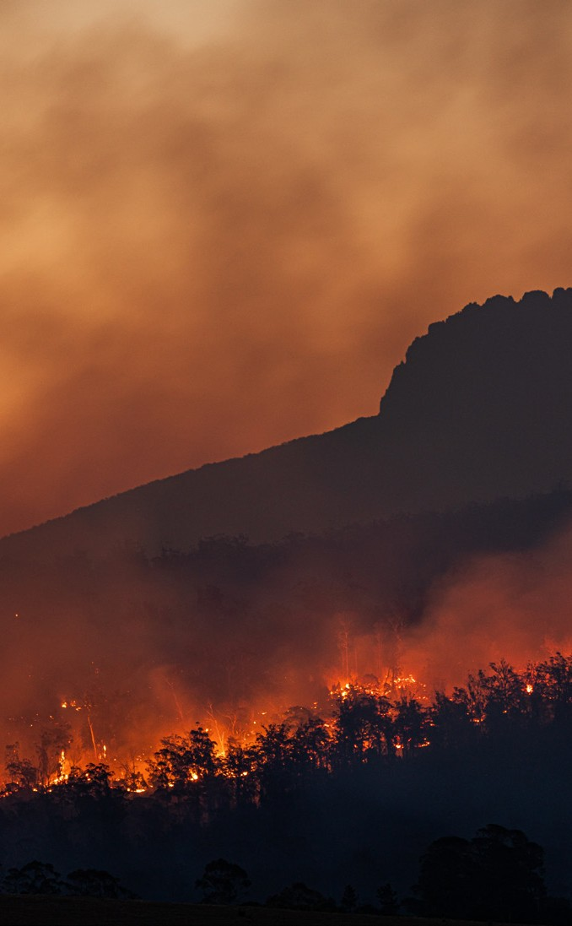
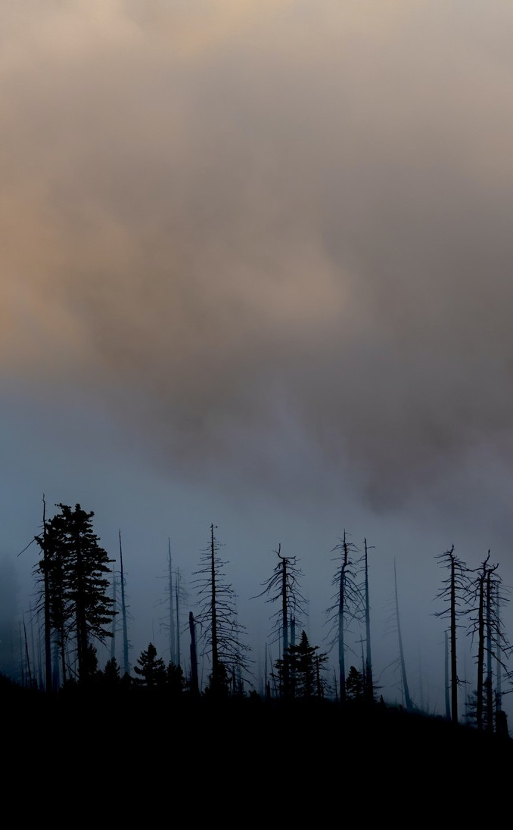
Pilots
Italy
3. Mediterranean Forest Fires
Pilot site: Montiferru (Sardinia)
The Autonomous Region of Sardinia (RAS) faced a severe crisis on July 2021, when
a widespread 15.000-hectare forest fire provoked serious damages at Montiferru (central Sardinia). This scenario will be played out in real time for TEMA validation, with available data about the area vegetation, geomorphological data, damage details and safety procedures that have been adopted, output of meteorological models, forecast
fire danger bulletins, satellite images, videos from drones filming the burnt area. The TEMA platform will also be used for examining
the conditions of post-event territory, with particular regard to the implications for geomorphological risk.
Finland
4. Finnish Forest Fires
Pilot site: Kainuu area
Forest fires and the general extreme weather conditions in the Nordic countries, cause concern among Finnish emergency professionals. The pilot will be based on the historical scenario of the 2021 Kalajoki forest fire. This will provide a study case on forest fire management operations through the aggregation of environmental data sources,
both existing and collected during the project. These datasets will be enriched with earlier reports on prevention strategies, as well as guidelines of the Finnish authorities for the boreal vegetation environment. By using TEMA solution, it will be possible to examine and improve procedures for managing disasters and for decision making.

Slide 15
Results
and Benefits

Slide 16
Key Results
Advanced real-time visual and social media analytics software
Advanced real-time visual and social media analytics software
Advanced information fusion software for heterogeneous data sources Novel XAI algorithms for multimodal analysis
Advanced federated analytics middleware for edge-to-cloud continuum paradigms
Near-real-time forest fire and flood modeling software
Advanced visual privacy preservation software

Slide 17
Key Results
Advanced response planning software for optimal sensor placement
Rapid and robust Digital Twin and geovisual analytics software NDM-AaaS software
University and continuing (e-)education content
A set of proposed technical standards for extreme data analysis 4 Pilot Trials in disaster management scenarios.

Slide 18
Impact
Scaling-up European capacity for extreme data analytics.
Explainable, robust and humanly
verifiable analytics
Fast and precise phenomenon prediction and response planning
Reduction of emergency response times during NDM
Improvement of decision making during NDM
Boost the EU policy agenda in the Data Spaces domain, as well as in the adoption of Decision Support Systems for emergency management
Quantification of the effectiveness of the integrated solution in realistic disaster management scenario
Opening up a new market segment via the envisioned Extreme-Analytics-as-a-Service, which makes select TEMA methods available to external users via the cloud and standardized interfaces.

Slide 19
Meet the Consortium

Slide 20
The Consortium

Slide 21
Thank you for your attention

